Slide 1

Bandwidth Decoupled Filterbank Optimization for Stress Recognition in Speech
Piyush Agnihotri
Roll No.- 184102304
Under the Supervision of
Prof. Samarendra Dandapat
Department of Electronics and Electrical Engineering Indian Institute of Technology, Guwahati
MTP
8 June, 2020
Piyush Agnihotri, 184102304
Bandwidth Decoupled Filterbank Optimization for stress recognition in speech

Slide 2

Outline
Introduction
Background
Bandwidth Decoupled Filter bank Optimization
Results and Discussion
Conclusion and Future work
References
Piyush Agnihotri, 184102304
Bandwidth Decoupled Filterbank Optimization for stress recognition in speech

Slide 3
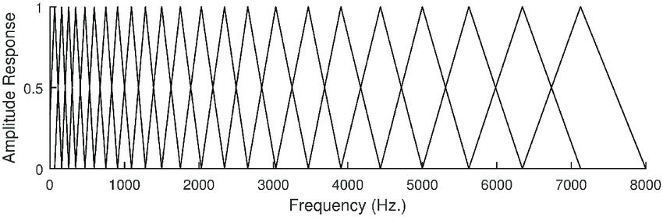

Introduction
MFCC is the most widely used speech representation based on the linear voice production model.
Conventional MFCC typically uses Mel-scaled filter bank (MFB) for extracting cepstral features.
In MFB, the amplitude of each filter is set to one and the bandwidth is determined by the spacing of filters center frequencies.
Figure 1.1: Classical Mel-scaled filter bank
Piyush Agnihotri, 184102304
Bandwidth Decoupled Filterbank Optimization for stress recognition in speech

Slide 4
Literature Survey
In [1], the filter center frequency is taken as a parameter for optimization using Evolutionary Algorithm (EA) with a constraint of half overlapping.
As the number of filters increases in the filter bank, the size of chromosomes also increases resulting in large search area [1].
In [2], a new approach called Evolutionary splines cepstral coefficients (ESCCs) was used to optimize the filter bank.
Here the parameters of filter were not directly encrypted by the chromosomes instead it uses two splines function to optimize the filter bank [2].
It includes only the optimization of filters amplitude and center frequency.
[1] L. D. Vignolo, H. L. Rufiner, and Milone, “Evolutionary cepstral coefficients,” Applied Soft Computing, vol. 11, no. 4, pp. 3419–3428, 2011.
[2] L. D. Vignolo, H. L. Rufiner, D. H. Milone, and J. C. Goddard, “Evolutionary splines for cepstral filterbank optimization in phoneme classification,” EURASIP Journal on Advances in Signal Processing, vol. 2011, p. 8, 2011.
Piyush Agnihotri, 184102304
Bandwidth Decoupled Filterbank Optimization for stress recognition in speech

Slide 5
Motivation
As the whole auditory system is not fully explored, there is still a battle for the optimal filter bank.
Much work had been done in the past for the optimization of Mel filter bank but still the bandwidth has not been considered as a parameter to design the filter bank.
In previous works, spline parameters were considered to design the optimal filter bank but still, some more modifications can be done in terms of new parameters to further smoothen the spline and help in optimization.
[1] L. D. Vignolo, H. L. Rufiner, and Milone, “Evolutionary cepstral coefficients,” Applied Soft Computing, vol. 11, no. 4, pp. 3419–3428, 2011.
[2] L. D. Vignolo, H. L. Rufiner, D. H. Milone, and J. C. Goddard, “Evolutionary splines for cepstral filterbank optimization in phoneme classification,” EURASIP Journal on Advances in Signal Processing, vol. 2011, p. 8, 2011.
Piyush Agnihotri, 184102304
Bandwidth Decoupled Filterbank Optimization for stress recognition in speech

Slide 6
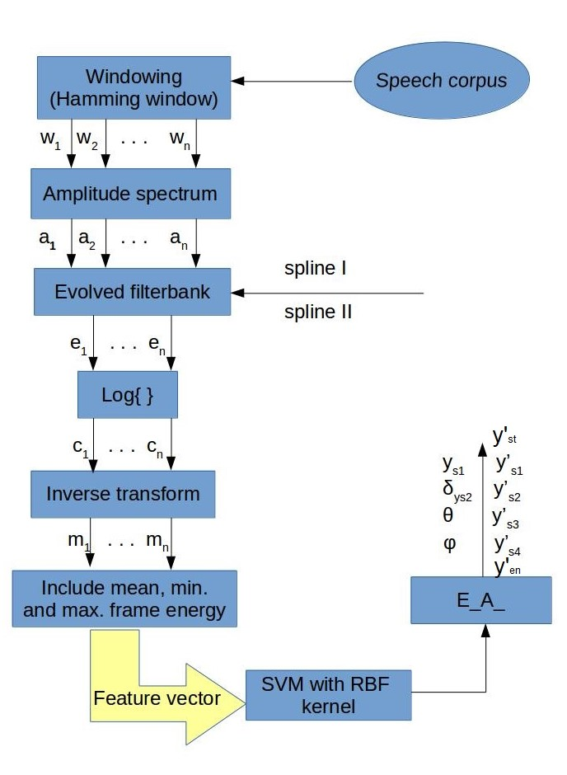
Background
Figure 1.2: Block diagram showing the feature extraction technique using derived filter bank.
Piyush Agnihotri, 184102304
Bandwidth Decoupled Filterbank Optimization for stress recognition in speech

Slide 7
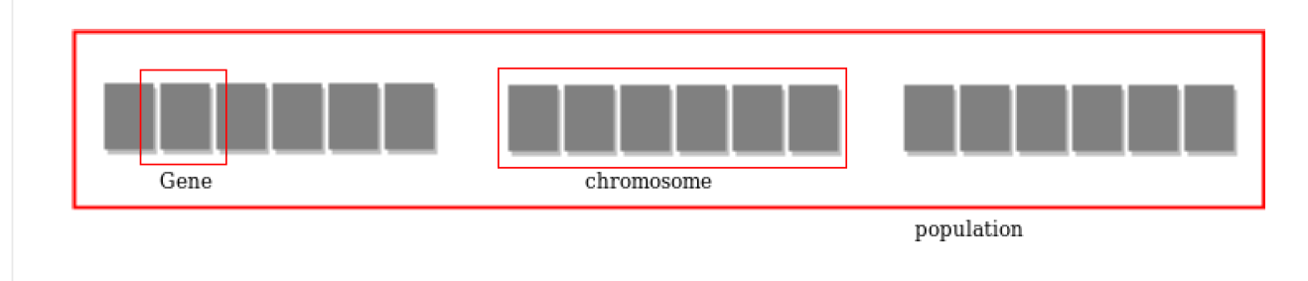
Evolutionary Algorithm
The population of individuals are maintained within search space. Each individual is coded as a finite length vector (analogous to chromosome) of components. These variable components are analogous to Genes.
Figure 2.1: Representation of chromosome in a population
Operators of Evolutionary Algorithms :-
Selection operator (tournament selection)
Crossover operator(one point crossover )
Mutation operator
Piyush Agnihotri, 184102304
Bandwidth Decoupled Filterbank Optimization for stress recognition in speech

Slide 8

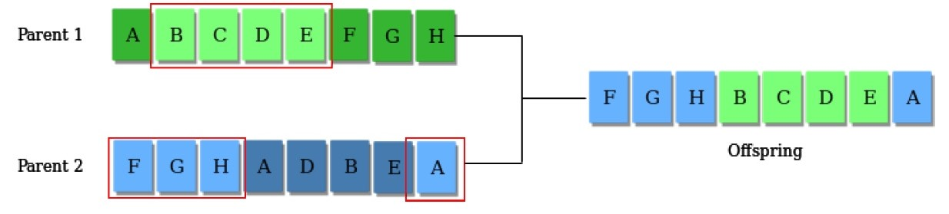
Figure 2.2: One-point crossover operator
Figure 2.3: Mutation operator
Elitist strategy: Elitist selection is a selection strategy where a limited number of individuals with the best fitness values are chosen to pass to the next generation, avoiding the crossover and mutation operators.
Piyush Agnihotri, 184102304
Bandwidth Decoupled Filterbank Optimization for stress recognition in speech

Slide 9
Sub-Band Wiener Filtering
The Wiener filter is a filter used to produce an estimate of a desired random process by LTI filtering of an observed noisy process, assuming known stationary signal and noise spectra, and additive noise.
The Wiener filter minimizes the average square error between the estimated random process and the desired process.
It is presumed that the speech and noise signals are additive and distinct.
X_{est} → Spectrum of t^{th} frame of the observed (noisy) signal
N(w, t) → Spectrum of t^{th} frame of the noise signal
S(w, t) → Spectrum of t^{th} frame of the clean signal
[4] H. Yeganeh, S. M. Ahadi, S. Mirrezaie, and A. Ziaei, “Weighting of mel sub-bands based on snr/entropy for robust asr,” in 2008 IEEE International Symposium on Signal Processing and Information Technology. IEEE, 2008, pp. 292–296.
Piyush Agnihotri, 184102304
Bandwidth Decoupled Filterbank Optimization for stress recognition in speech

Slide 10
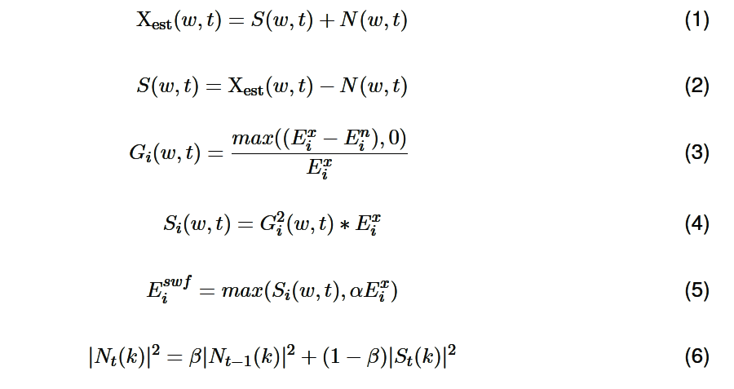
α → flooring parameter
β → forgetting parameter
G_{i}(w, t) → sub-band wiener filter
|S_{t} (k)| ² → Power spectrum of the current frame
|N_{t}(k)|² → Estimated noise power spectrum of the current frame
Piyush Agnihotri, 184102304
Bandwidth Decoupled Filterbank Optimization for stress recognition in speech

Slide 11
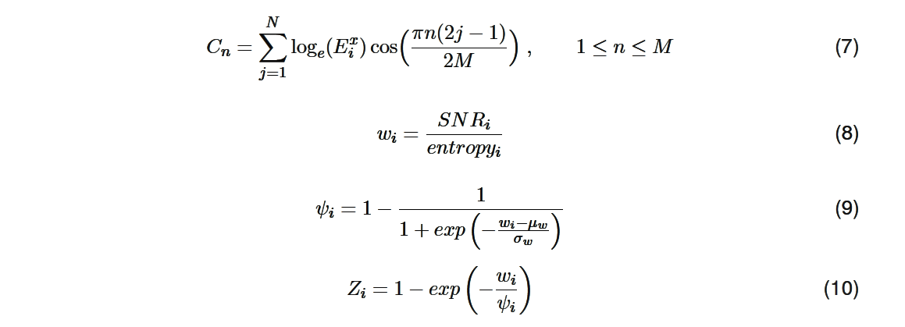
Weighted MFCC
As it can be observed from the Eq. (7) that the conventional MFCC estimation is having drawback under noisy condition.
The drawback is that, even in the noisy environment the below formula will give equal weightage to all the sub-band energies.
Piyush Agnihotri, 184102304
Bandwidth Decoupled Filterbank Optimization for stress recognition in speech

Slide 12
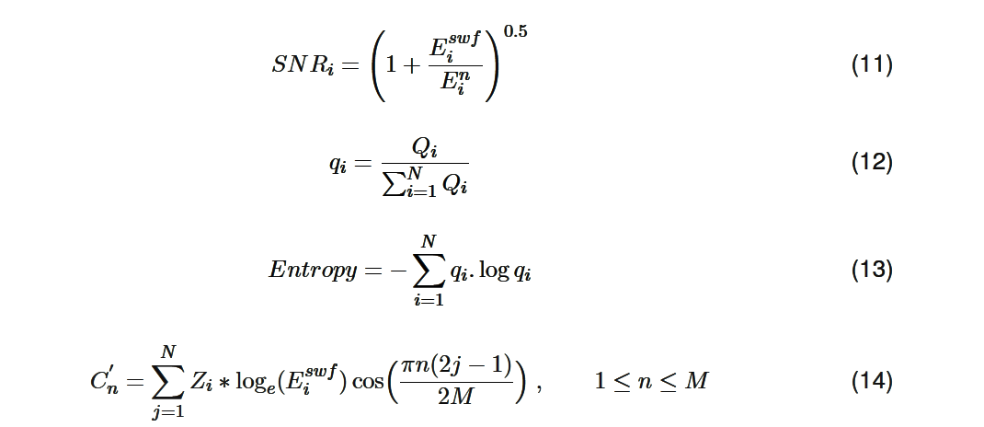
To overcome this effect, one approach is to take the weighting of sub-band log energies in such a way that the sub-bands having less noise should be getting higher weights and vice-versa.
C_{n} → Cepstral coefficients before wiener filtering and weighted MFCC
C’_{n} → Cepstral coefficients after wiener filtering and weighted MFCC
Piyush Agnihotri, 184102304
Bandwidth Decoupled Filterbank Optimization for stress recognition in speech

Slide 13
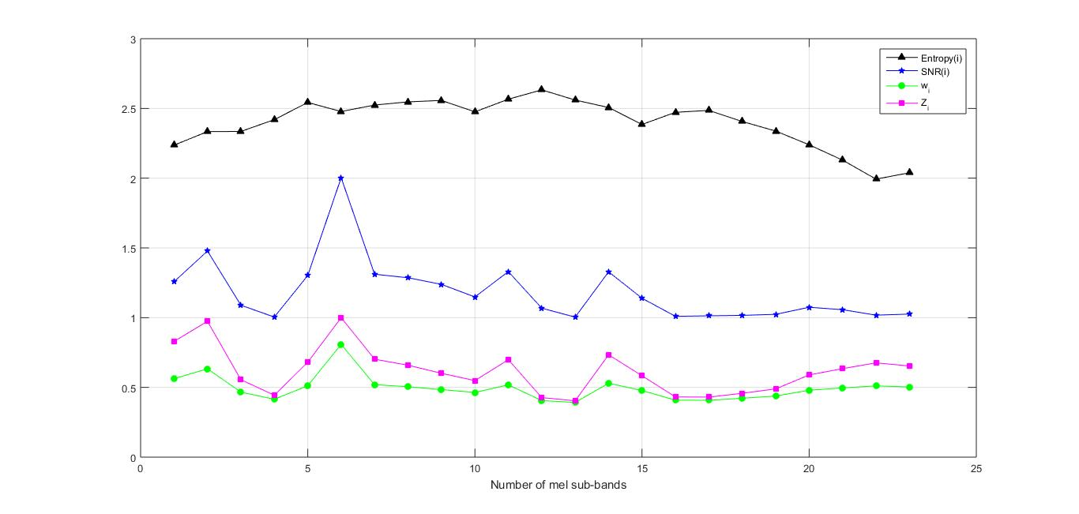
It can be interpreted from the figure that, when w_{i} is high, entropy is less and Z_{i} tends to close to one.
Figure 2.4: SNR, Entropy, w_{i} and Z_{i} values in different mel sub-bands for a noisy speech frame in presence of AWGN noise at 0 dB SNR.
Piyush Agnihotri, 184102304
Bandwidth Decoupled Filterbank Optimization for stress recognition in speech

Slide 14
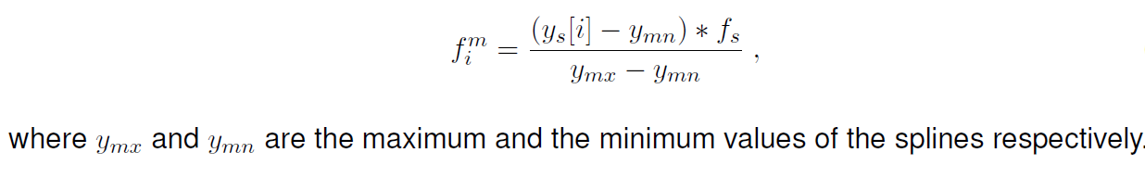
Bandwidth Decoupled Filterbank Optimization
Filter center frequency optimization:-
Here four parameters were used for the optimization. The starting two parameters are the values of splines y_{s1} and y_{s2} for two fixed values of x_{s1} and x_{s2} such that, x_{s1} < x_{s2} , and the other two parameters are theta and alpha, derivatives at the fixed points (x_{s} = 0, y_{s} = 0) and (x_{s}= 1, y_{s} = 1) respectively.
The values of y obtained through splines were linearly mapped to the frequency range, from 0 Hz to f_{s} /2, to get the frequency values (f^{m}), where the filter reaches maximum values.
Piyush Agnihotri, 184102304
Bandwidth Decoupled Filterbank Optimization for stress recognition in speech

Slide 15

2. Design Parameter: Bandwidth
Bandwidth in BDCCs is a design parameter that is decoupled from filter spacing.
Using Moore and Glasberg’s approximation [3] of critical bandwidth and the prior information of the center frequency determined from spline 1, the bandwidth of each filter can be calculated by,
[3] B. C. Moore and B. R. Glasberg, “Suggested formulae for calculating auditory-filter bandwidths and excitation patterns,” The journal of the acoustical society of America, vol. 74, no. 3, pp. 750–753, 1983.
Piyush Agnihotri, 184102304
Bandwidth Decoupled Filterbank Optimization for stress recognition in speech

Slide 16
Filter amplitude optimization:-
The second spline was only having the constraints of lying in the range of [0, 1], but values of y at x_{s} = 0 and x_{s} = 1 were not fixed.
The values of spline, y’_{st} , y’_{s1} , y’_{s2} , y’_{s3} , y’_{s4} and y’_{en} for the fixed values of x’_{st ,} x’_{s1} , x’_{s2} , x’_{s3} , x’_{s4} , and x’_{en} , were to be optimized in this section.
Using these values of y_{s}, n_{f} interpolated values were obtained to set the amplitude of the filters.
So finally we got a chromosome of length 10 and a total of 30 chromosomes has been used in this work.
Piyush Agnihotri, 184102304
Bandwidth Decoupled Filterbank Optimization for stress recognition in speech

Slide 17
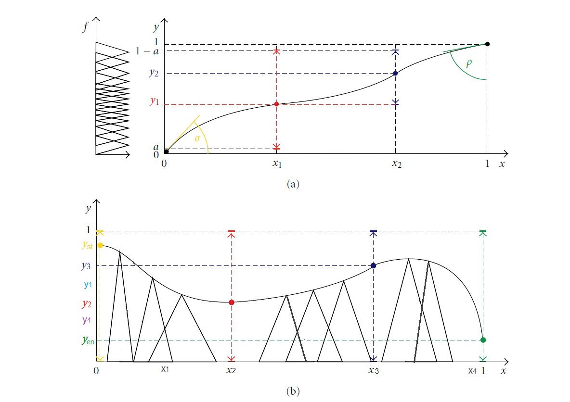
Figure 3.1: (a) A spline being optimized to determine the frequency position of filters, and (b) a spline being optimized to determine the amplitude of the filters.
Piyush Agnihotri, 184102304
Bandwidth Decoupled Filterbank Optimization for stress recognition in speech

Slide 18
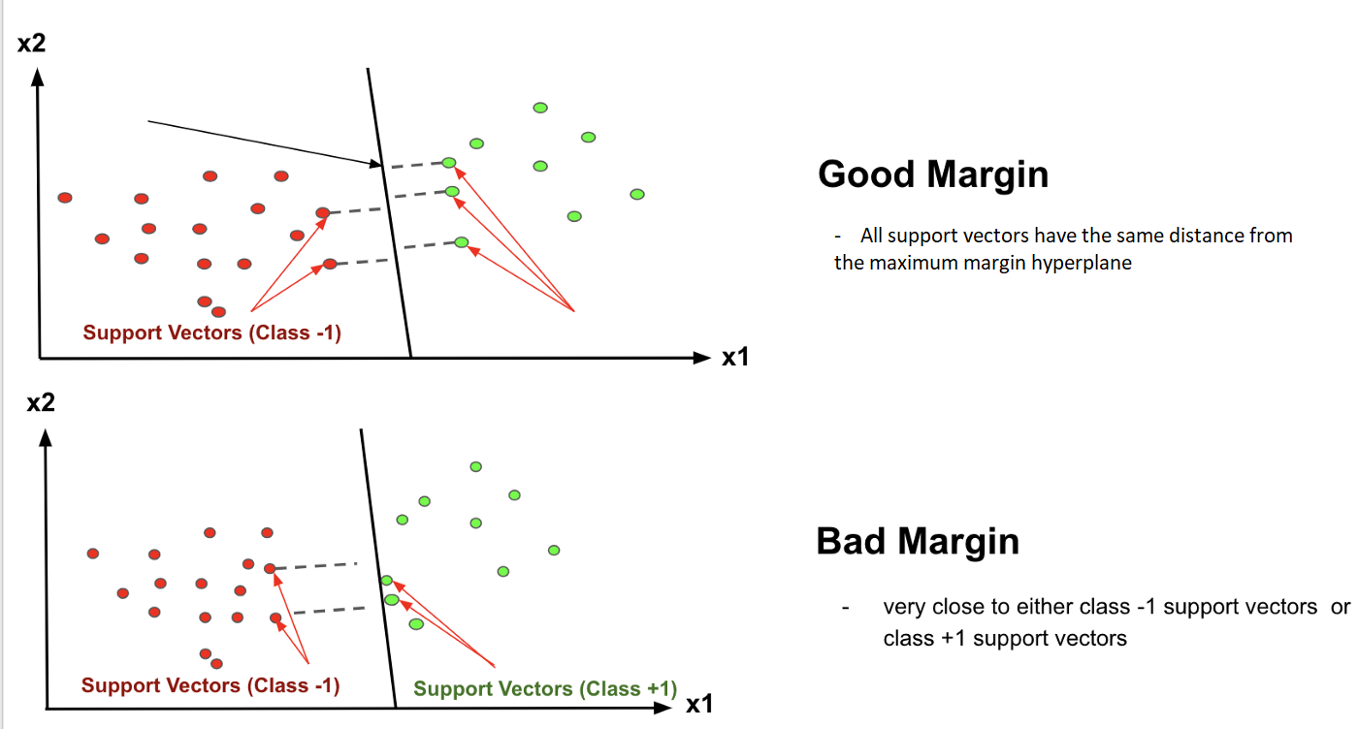
Brief of Support Vector Machine
In machine learning, compared to both logistic regression and neural networks the SVM often gives a cleaner and more powerful way of learning complex non-linear functions.
Figure 3.2: Difference in Good and Bad Margin
Piyush Agnihotri, 184102304
Bandwidth Decoupled Filterbank Optimization for stress recognition in speech

Slide 19
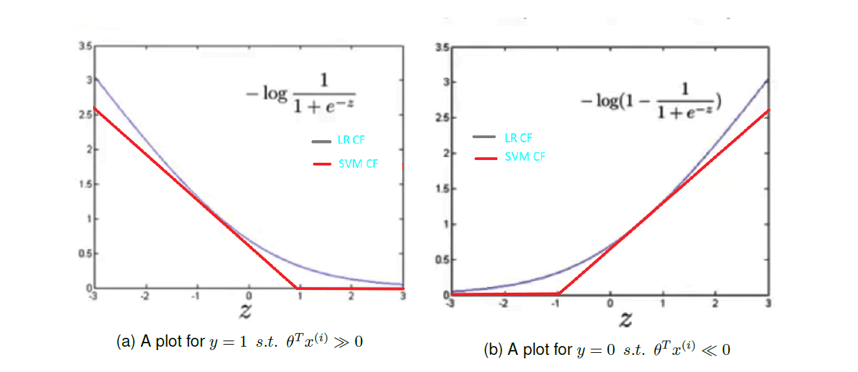
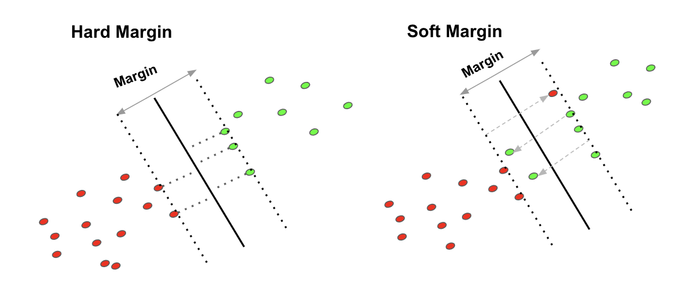
Figure 3.3: Difference between Hard and Soft Margin
Figure 3.4: Comparison of cost function (CF) of Logistic Regression (LR) and SVM
Piyush Agnihotri, 184102304
Bandwidth Decoupled Filterbank Optimization for stress recognition in speech

Slide 20
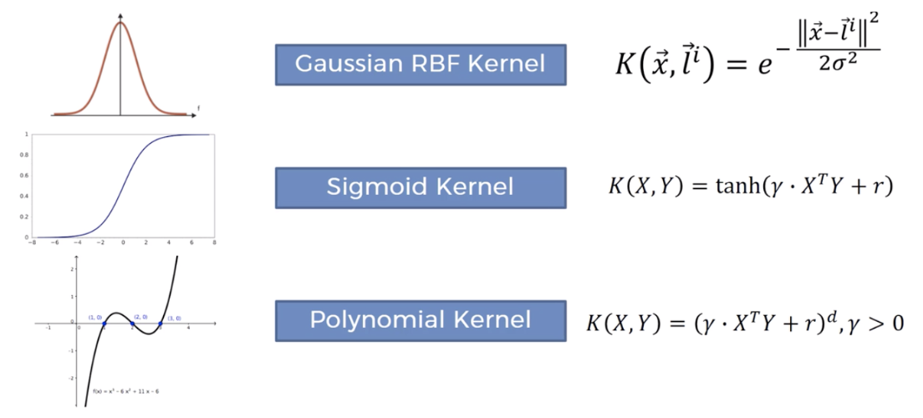
SVM Hyperparameter Tuning
Kernels
C (Regularisation)
Gamma
Figure 3.5: Different types of kernel used by SVM Classifier
Piyush Agnihotri, 184102304
Bandwidth Decoupled Filterbank Optimization for stress recognition in speech

Slide 21
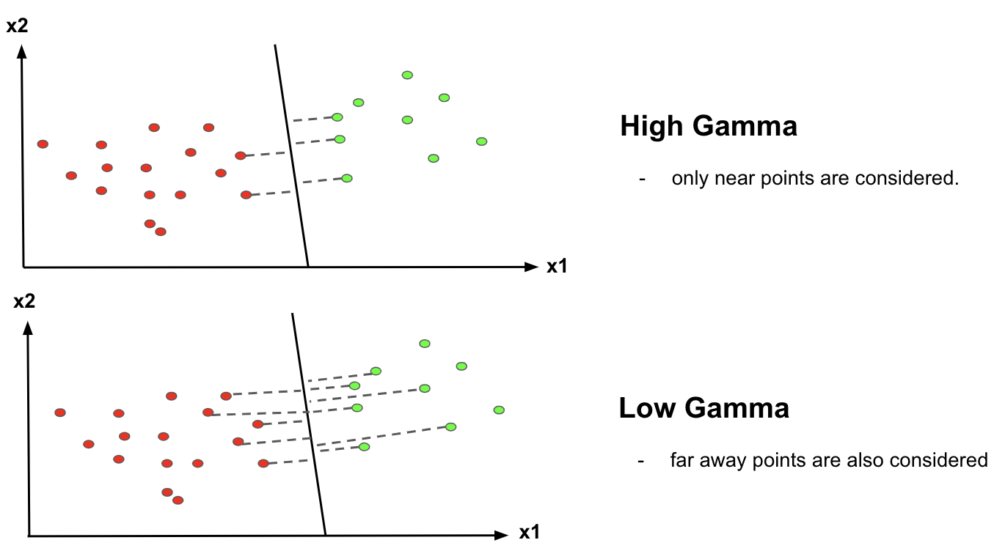
Fig. 3.6 shows, when gamma is higher, nearby points will have high influence whereas low gamma means far away points will also be considered to get the decision boundary.
Figure 3.6: Influence of Gamma values on support vector points.
Piyush Agnihotri, 184102304
Bandwidth Decoupled Filterbank Optimization for stress recognition in speech

Slide 22
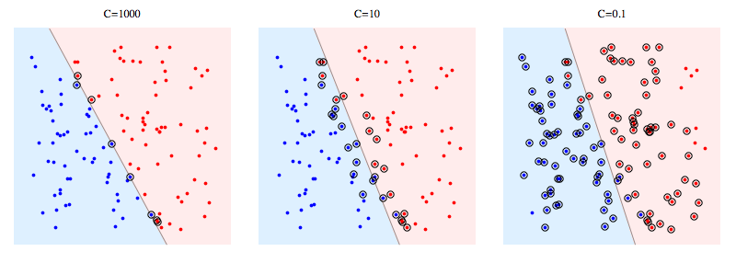
C is the parameter of penalty, which is misclassification or error term.
Fig. 3.7 shows that when C is high it will classify all the data points correctly, also there is a chance to over fit.
Figure 3.7: Classification of datapoints based on C values.
Piyush Agnihotri, 184102304
Bandwidth Decoupled Filterbank Optimization for stress recognition in speech

Slide 23
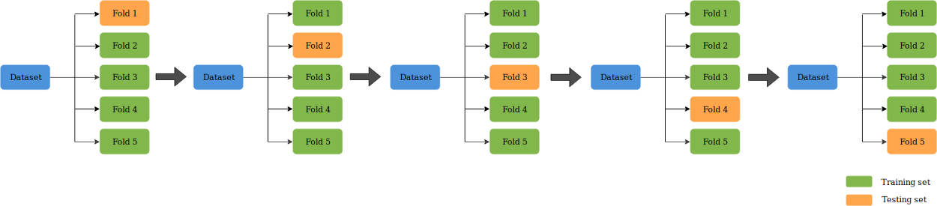
K-Fold Cross Validation
The approach of testing the performance of the model based on an error metric to assess the model’s precision is not very accurate.
It’s because the accuracy obtained for one test set may vary considerably from the accuracy obtained for a different test set.
Figure 3.8: 5-Fold Cross Validation
Piyush Agnihotri, 184102304
Bandwidth Decoupled Filterbank Optimization for stress recognition in speech

Slide 24
Results and Discussion
An experiment has been performed to calculate 10-Fold CV on two different feature vector.
Firstly, we obtained the 42 dimensional feature vector (13 MFCC + 13 + 13 + 3 frame energies) through conventional Mel-scaled bank.
Secondly, we obtained the 13 dimensional conventional MFCC feature vector.
After that we performed 10-Fold CV on both of these feature vectors and came up with some comparison.
Table 4.1 and 4.2 shows performance of conventional MFCC after 10-folds cross-validation using 42 dim. conventional feature vectors and 13 dim. feature vectors for different noisy conditions respectively.
Piyush Agnihotri, 184102304
Bandwidth Decoupled Filterbank Optimization for stress recognition in speech

Slide 25
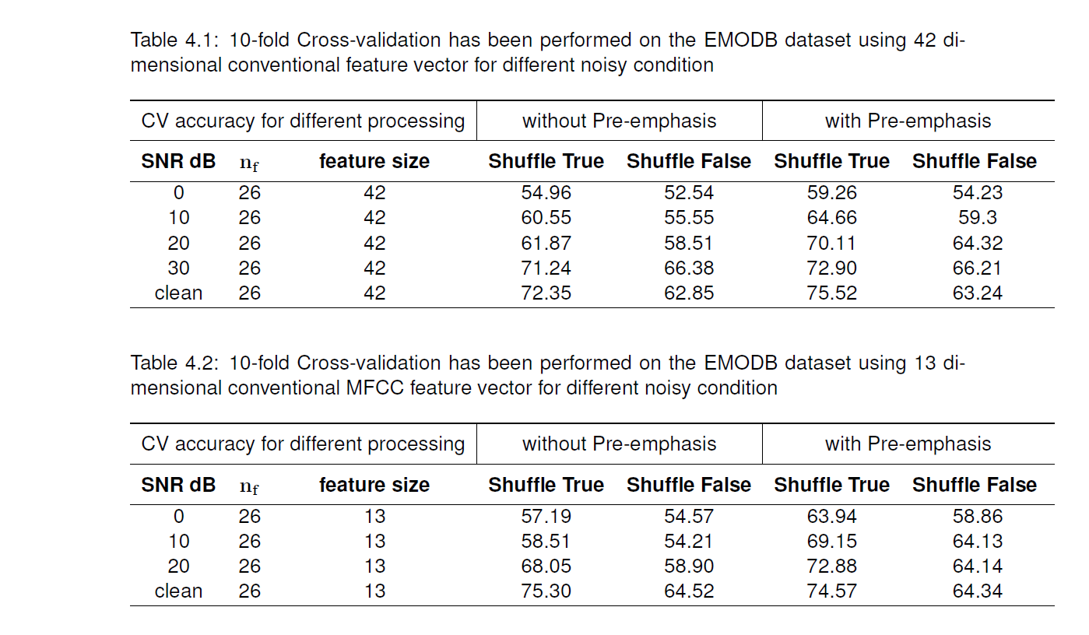
The results obtained for signal preprocessing i.e. with pre-emphasis is much better than operations carried without pre-emphasis.
Piyush Agnihotri, 184102304
Bandwidth Decoupled Filterbank Optimization for stress recognition in speech

Slide 26
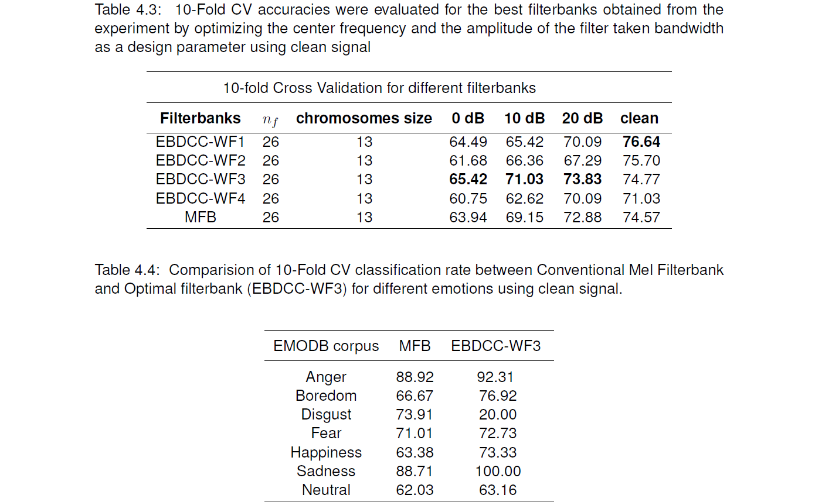
It is clearly observable that our proposed evolved filter banks (EBDCC) has performed better than the conventional mel-filterbanks under every noisy conditions.
Piyush Agnihotri, 184102304
Bandwidth Decoupled Filterbank Optimization for stress recognition in speech

Slide 27
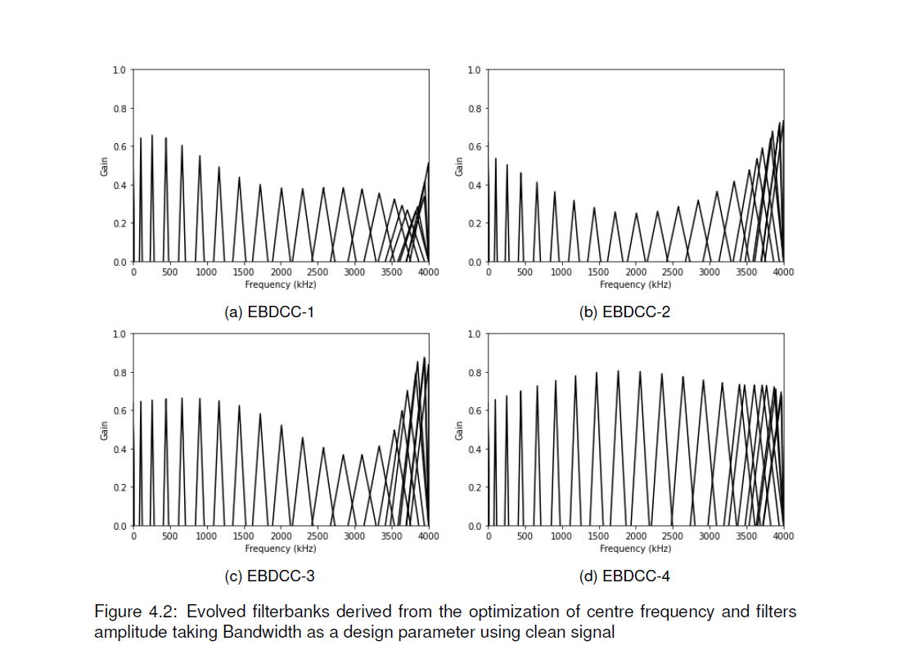
Piyush Agnihotri, 184102304
Bandwidth Decoupled Filterbank Optimization for stress recognition in speech

Slide 28
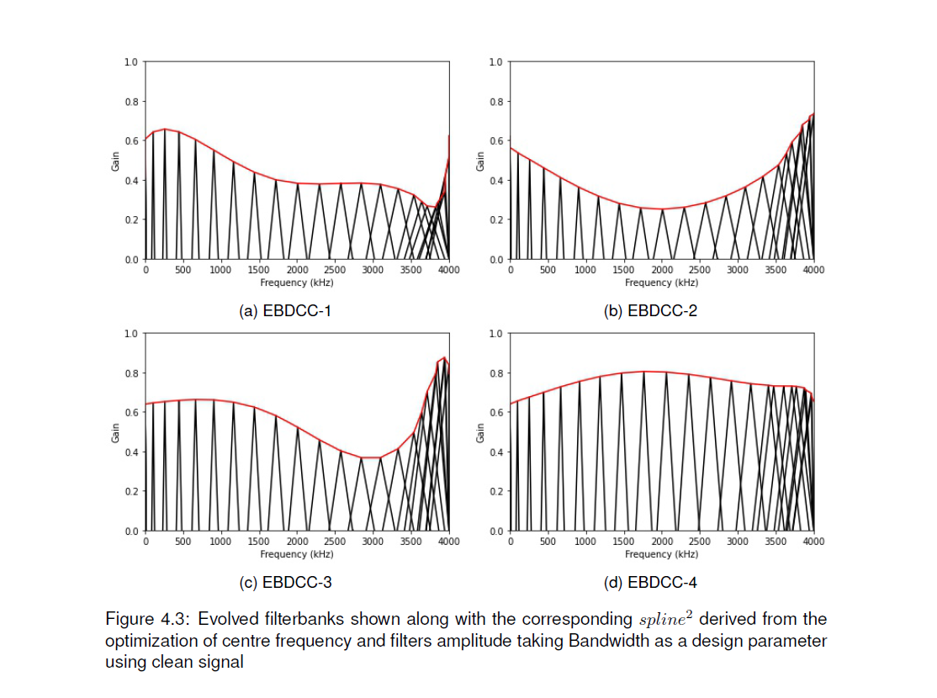
Piyush Agnihotri, 184102304
Bandwidth Decoupled Filterbank Optimization for stress recognition in speech

Slide 29
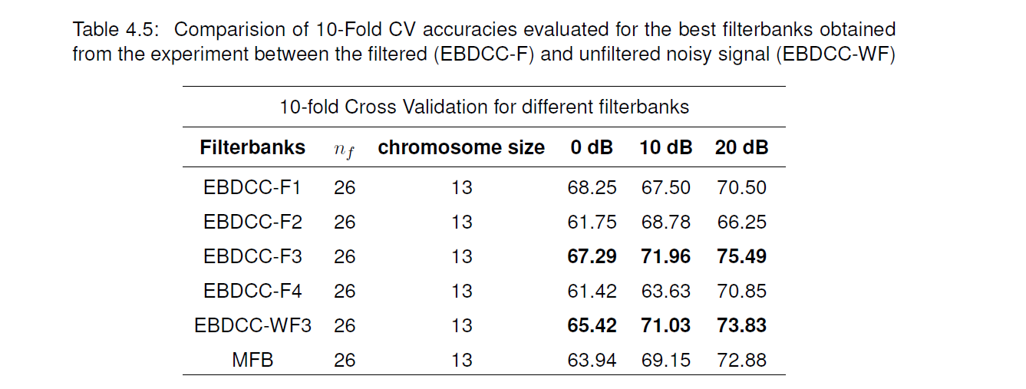
Table 4.5 shows, EBDCC-F3 has better classification rates as compared to EBDCC-WF3 and MFB for every noisy environment.
This can be interpreted like that, the filter banks were evolved using clean speech signal and if we pass a signal with noise content then it’s accuracy and behaviour would decrease.
Piyush Agnihotri, 184102304
Bandwidth Decoupled Filterbank Optimization for stress recognition in speech

Slide 30
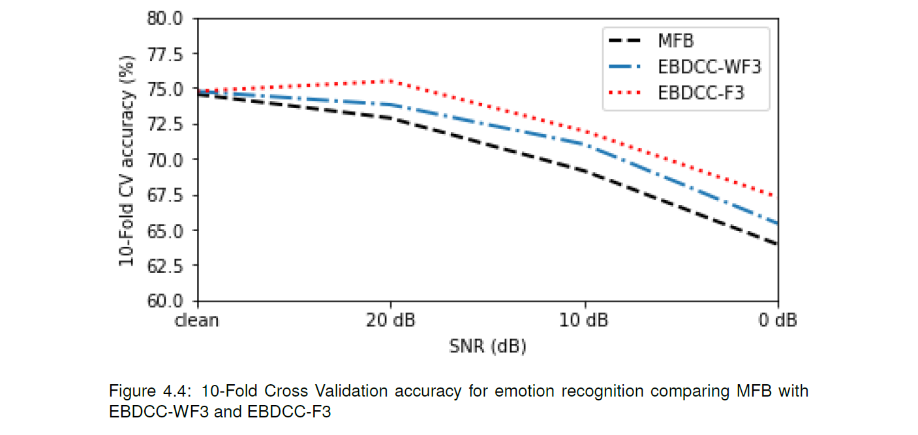
Analysis
Figure 4.4 shows that both the filters EBDCC-WF3 and EBDCC-F3 are classified at a higher rate than MFBs for different test conditions.
As EBDCC-F3 filter bank was tested for a noisy signal after filtering hence it’s Cross-validation accuracy was higher than the EBDCC-WF3 filter bank.
Piyush Agnihotri, 184102304
Bandwidth Decoupled Filterbank Optimization for stress recognition in speech

Slide 31
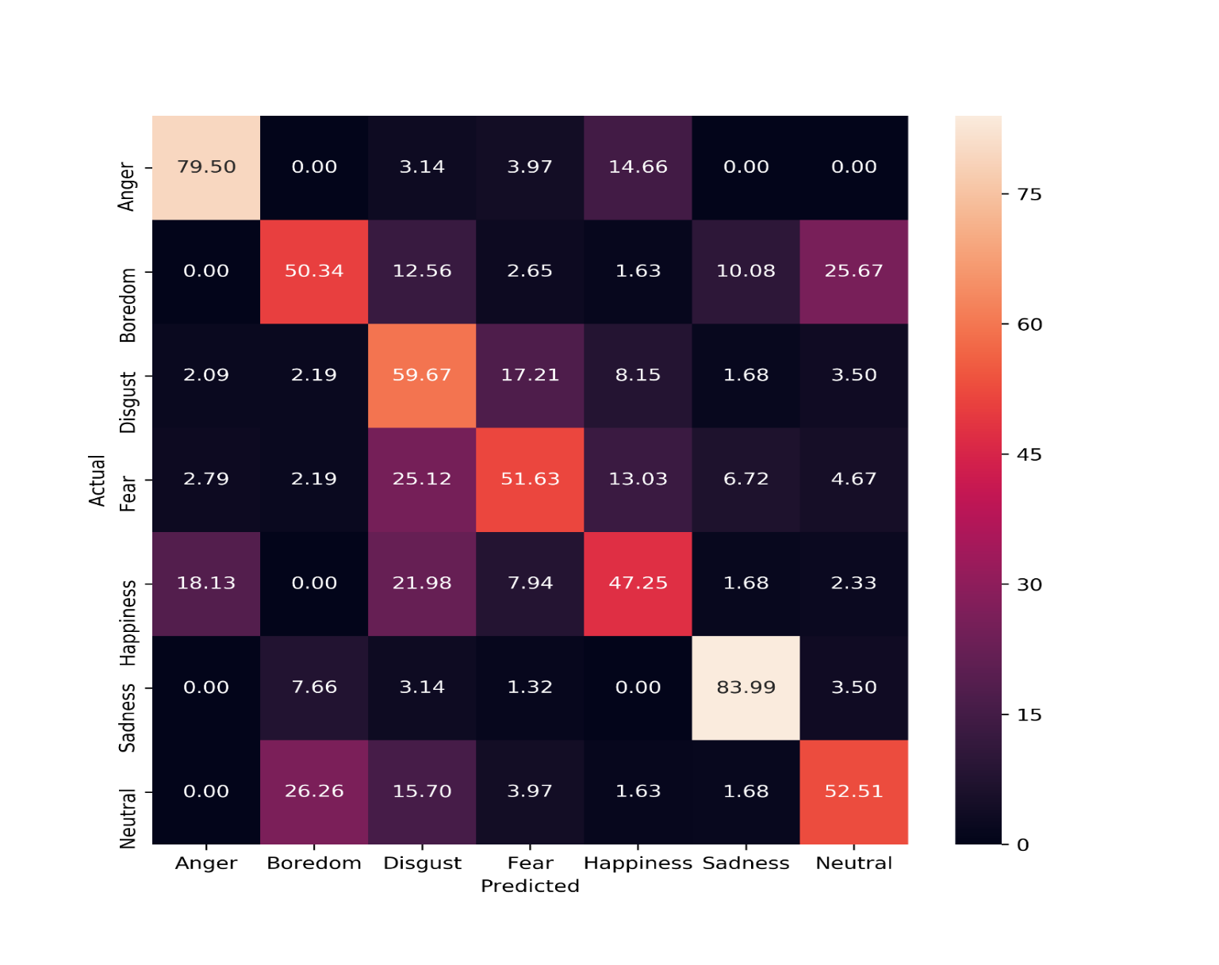
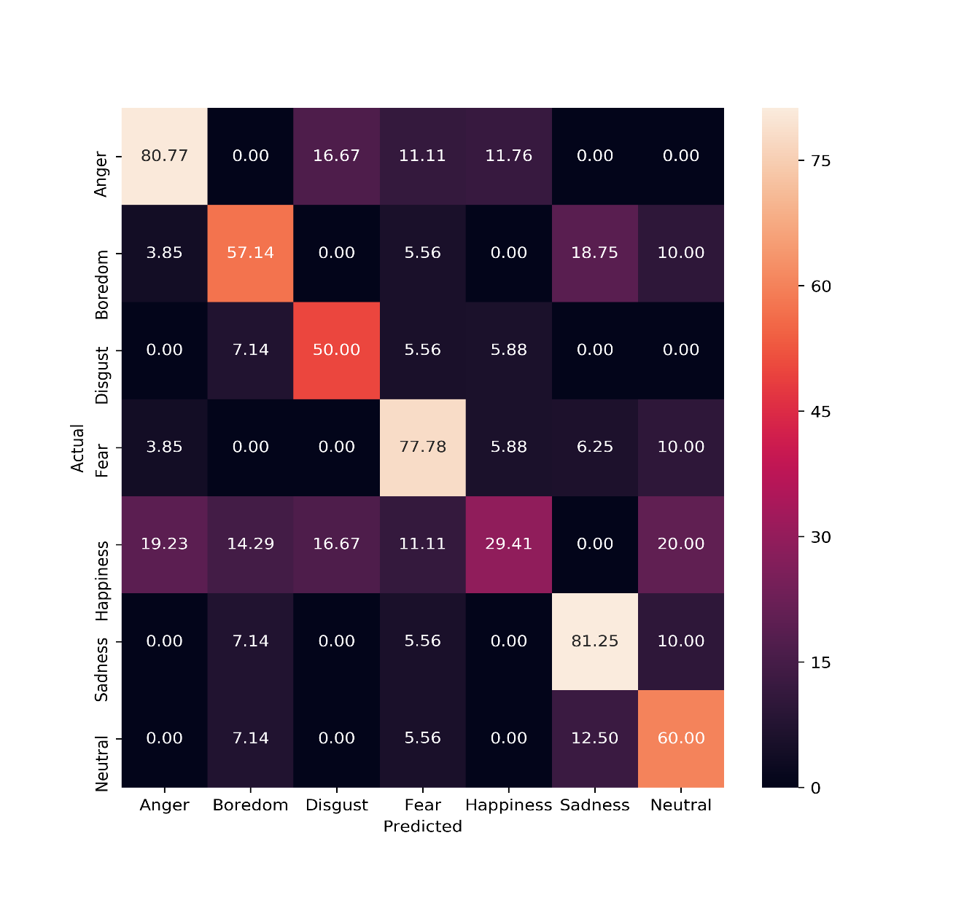
(a) Confusion matrix at 0 dB SNR
(b) EBDCC-WF3: Confusion matrix at 0 dB SNR
Figure 4.5: Comparison between confusion matrix of conventional MFCC & EBDCC-WF3 showing 10-Fold CV accuracy for the pre-emphasis signal at 0 dB SNR.
Piyush Agnihotri, 184102304
Bandwidth Decoupled Filterbank Optimization for stress recognition in speech

Slide 32

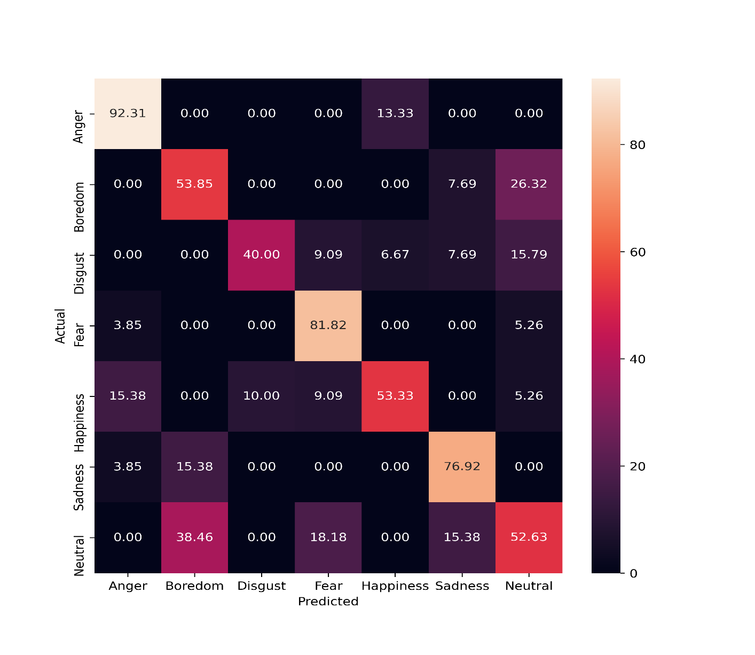
(a) EBDCC-WF3: Confusion matrix at 0 dB SNR
(b) EBDCC-F3: Confusion matrix at 0 dB SNR
Figure 4.6: Comparison between confusion matrix of EBDCC-WF3 & EBDCC-F3 showing 10-Fold CV accuracy for the pre-emphasis signal at 0 dB SNR.
Piyush Agnihotri, 184102304
Bandwidth Decoupled Filterbank Optimization for stress recognition in speech

Slide 33
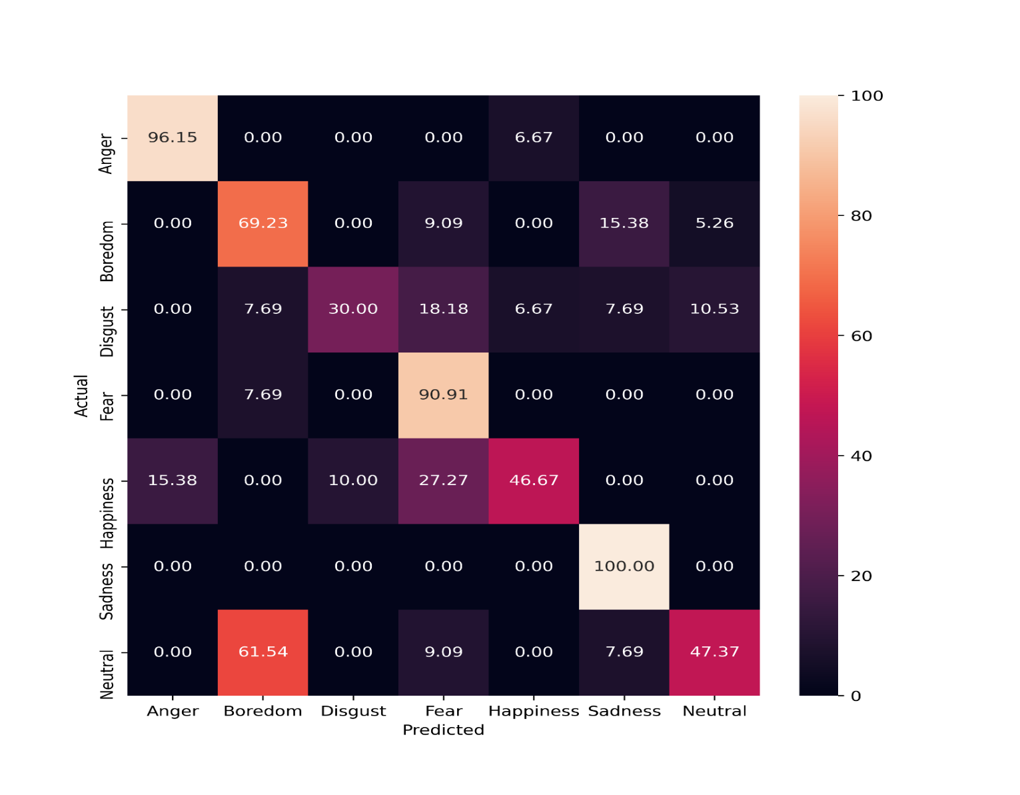
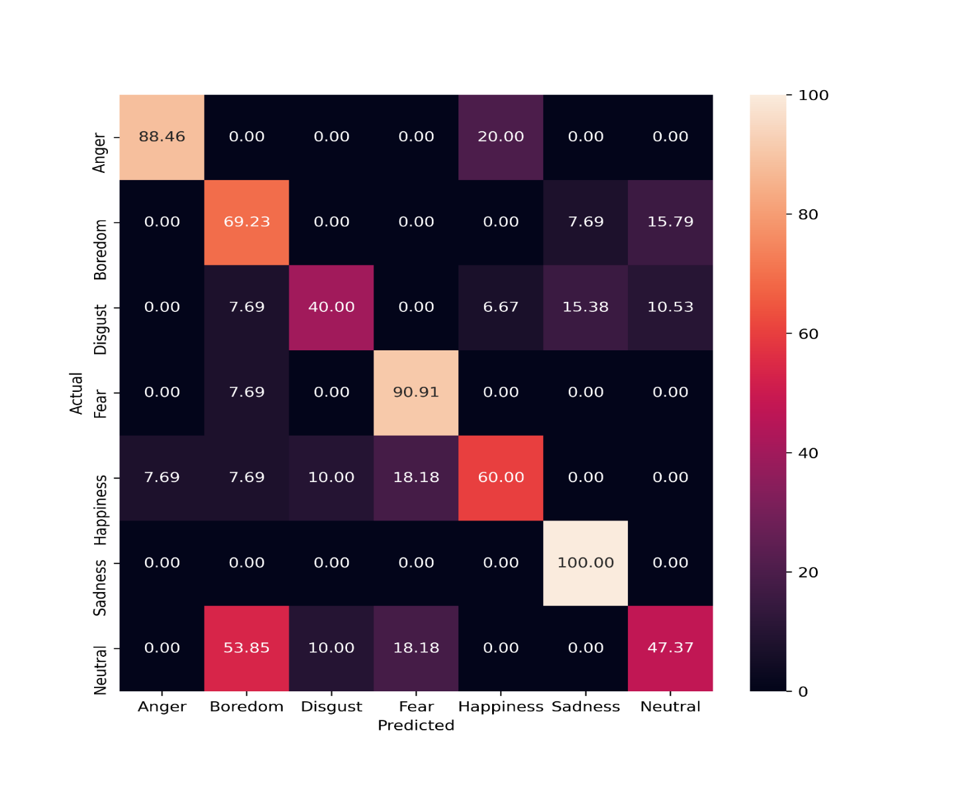
(a) EBDCC-WF3: Confusion matrix at 10 dB SNR
(b) EBDCC-F3: Confusion matrix at 10 dB SNR
Figure 4.7: Comparison between confusion matrix of EBDCC-WF3 & EBDCC-F3 showing 10-Fold CV accuracy for the pre-emphasis signal at 10 dB SNR.
Piyush Agnihotri, 184102304
Bandwidth Decoupled Filterbank Optimization for stress recognition in speech

Slide 34
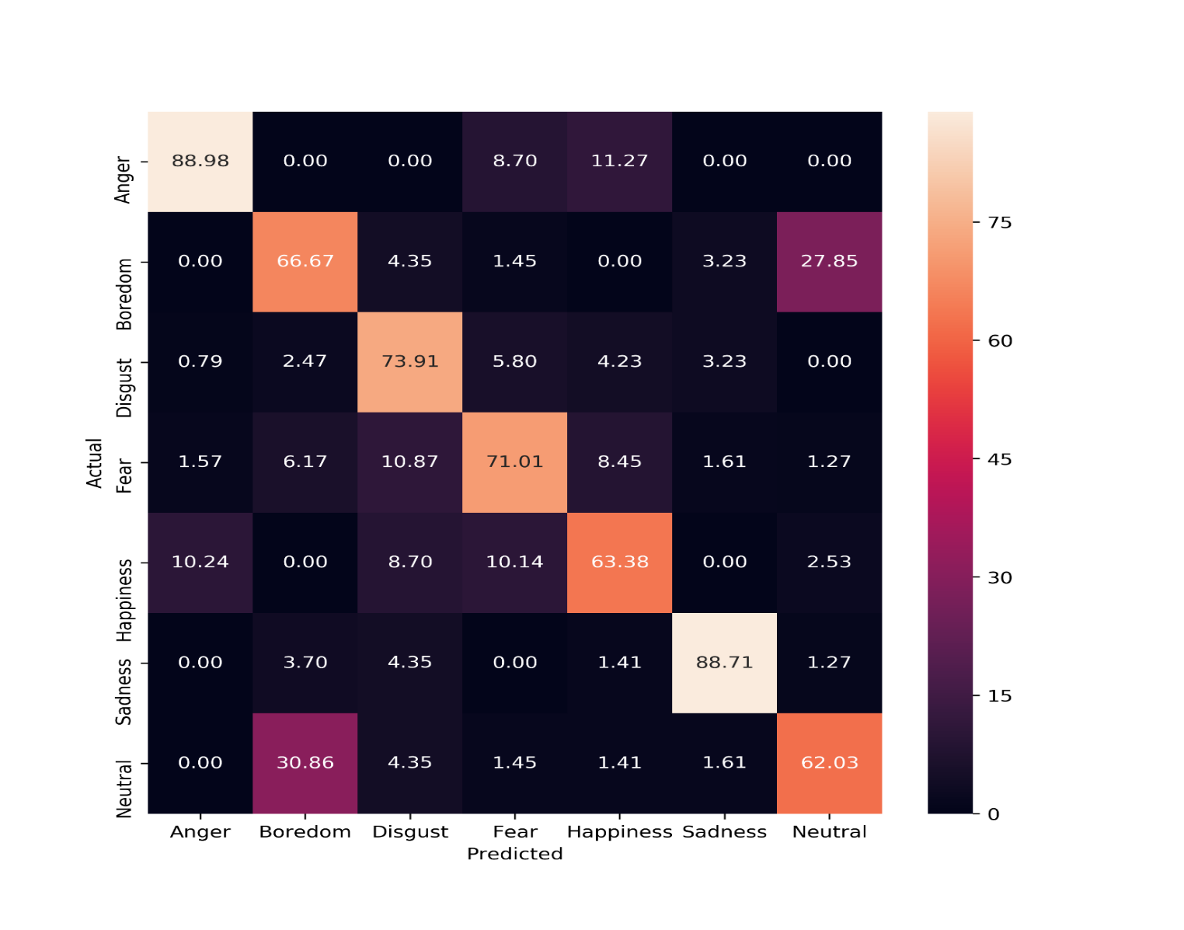
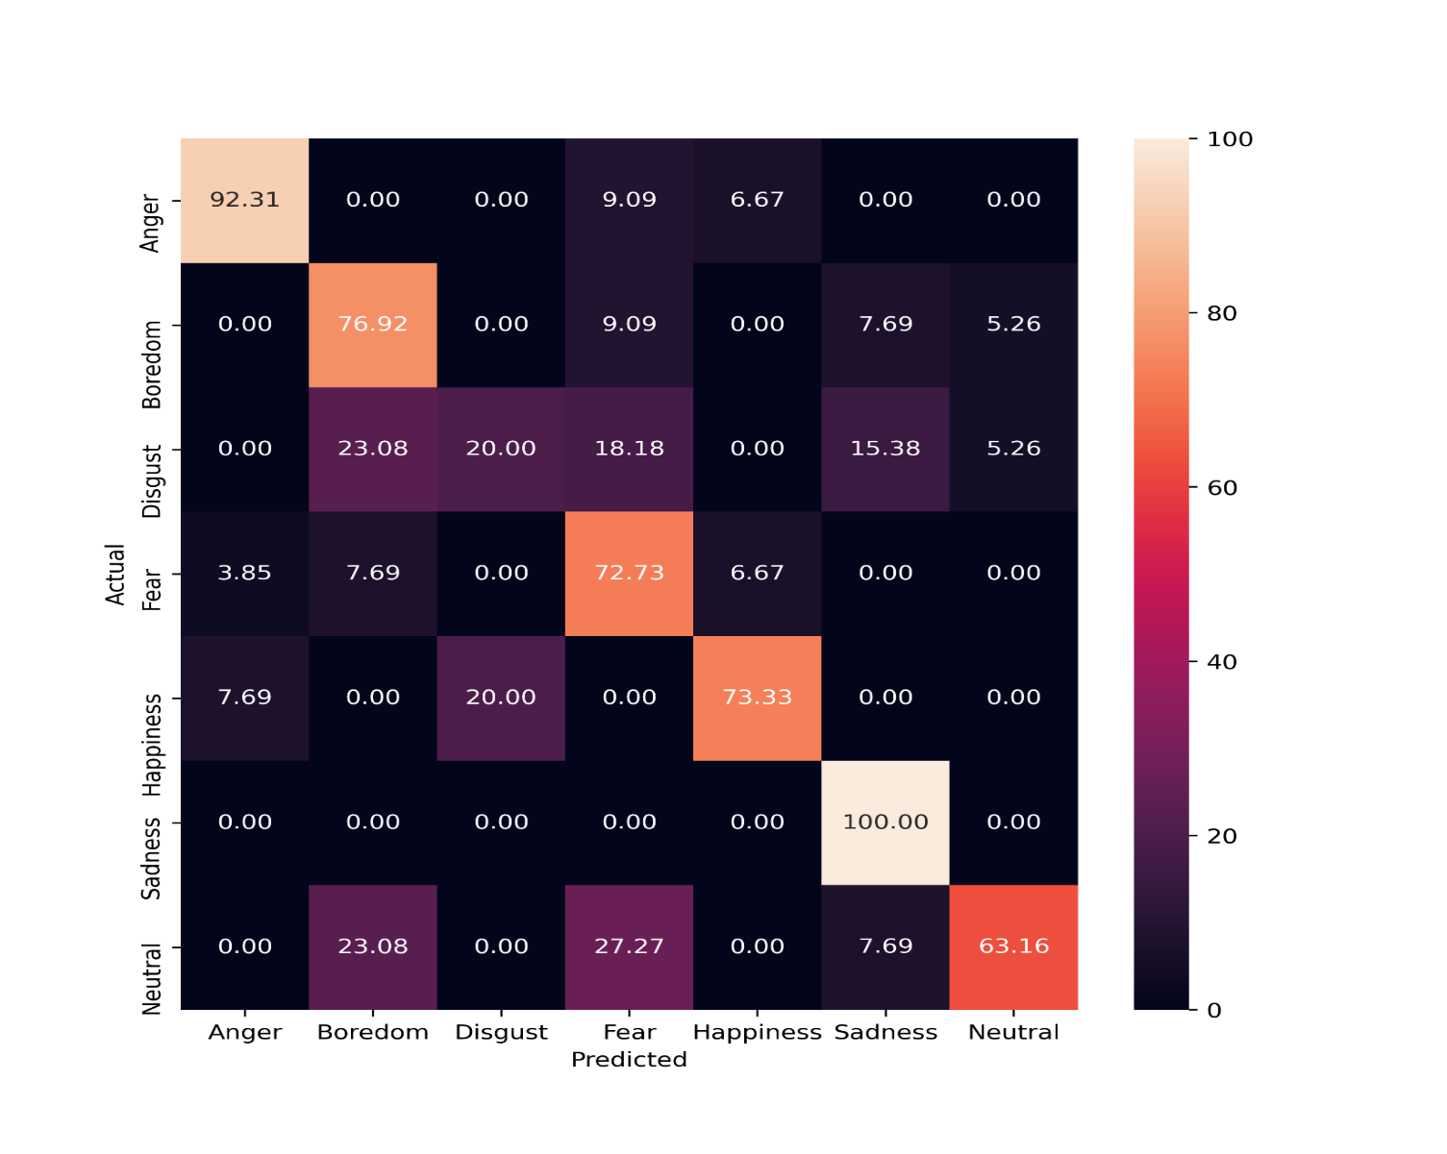
(a) Conv. MFCC: Confusion matrix for clean signal
(b) EBDCC-WF3/F3: Confusion matrix for clean signal
Figure 4.8: Comparison between confusion matrix of conventional MFCC & EBDCC-WF3/F3 showing 10-Fold CV accuracy for the pre-emphasis signal under clean condition.
Piyush Agnihotri, 184102304
Bandwidth Decoupled Filter bank Optimization for stress recognition in speech

Slide 35
Conclusion and Future Work
A novel feature BDCCs has shown a better recognition rate as compared to the existing MFCC feature under all noisy conditions.
EBDCCs has shown a good result when used with the filtered noisy signal under all testing environment.
The derived filter banks (EBDCCs) were evolved only for 120 generations and a maximum of 76.64% 10-Fold CV accuracy has been achieved for filter bank EDBCC-WF1.
In future, this accuracy can further be improved if we run it for more number of generations.
As, in this work, we have not designed filter banks under 0 dB SNR condition along with filtering, so future work can be carried out to further improve the robustness of the filter banks under noisy conditions.
Piyush Agnihotri, 184102304
Bandwidth Decoupled Filter bank Optimization for stress recognition in speech

Slide 36
References
L. D. Vignolo, H. L. Rufiner, and Milone, “Evolutionary cepstral coefficients,” Applied Soft Computing, vol. 11, no. 4, pp. 3419–3428, 2011.
L. D. Vignolo, H. L. Rufiner, D. H. Milone, and J. C. Goddard, “Evolutionary splines for cepstral filterbank optimization in phoneme classification,” EURASIP Journal on Advances in Signal Processing, vol. 2011, p. 8, 2011.
B. C. Moore and B. R. Glasberg, “Suggested formulae for calculating auditory-filter bandwidths and excitation patterns,” The journal of the acoustical society of America, vol. 74, no. 3, pp. 750–753, 1983.
H. Yeganeh, S. M. Ahadi, S. Mirrezaie, and A. Ziaei, “Weighting of mel sub-bands based on snr/entropy for robust asr,” in 2008 IEEE International Symposium on Signal Processing and Information Technology. IEEE, 2008, pp. 292–29.
H. Misra, S. Ikbal, H. Bourlard, and H. Hermansky, “Spectral entropy based feature for robust asr,” in 2004 IEEE International Conference on Acoustics, Speech, and Signal Processing, vol. 1. IEEE, 2004, pp. I–193.
P. Alexandre and P. Lockwood, “Root cepstral analysis: A unified view. application to speech processing in car noise environments,” Speech Communication, vol. 12, no. 3, pp. 277–288, 1993.
M. D. Skowronski and Harris, “Improving the filter bank of a classic speech feature extraction algorithm,” in Proceedings of the 2003 International Symposium on Circuits and Systems, 2003. ISCAS’03., vol. 4. IEEE, 2003, pp. IV–IV.
Piyush Agnihotri, 184102304
Bandwidth Decoupled Filter bank Optimization for stress recognition in speech

Slide 37
Thank You
Piyush Agnihotri, 184102304
Bandwidth Decoupled Filter bank Optimization for stress recognition in speech

